Slide 1
Structural Heart Program The Next Decade in Cardiac Care

Slide 2
Crozer Keystone Health System Heart and Vascular Care
Cardiovascular Service Line
Cardiology
Cardiothoracic Surgery
Electrophysiology
Interventional Cardiology
Cardio-Oncology
Vascular Surgery
Cardiac Rehabilitation
Structural Heart Program

Slide 3
Crozer Keystone Health System Structural Heart Program Team
Multidisciplinary Heart Team Approach
Collaboration between primary care physicians, referring physicians, cardiology, interventional cardiology and CT surgery
Coordinated care discussed at weekly heart team meeting, communication with specialists & primary care physicians
New Programs include TAVR and WATCHMAN

Slide 4
Transcatheter Aortic Valve Replacement (TAVR)

Slide 5
Transcatheter Aortic Valve Replacement (TAVR)
Transcatheter Aortic Valve Replacement (TAVR)
Procedure treats aortic stenosis – a progressive, life threatening disease
Less invasive, shorter hospital stay
Now offered closer to home at CCMC
Crozer Chester Medical Center performed the first TAVR Procedures in Delaware County in November, 2019

Slide 6
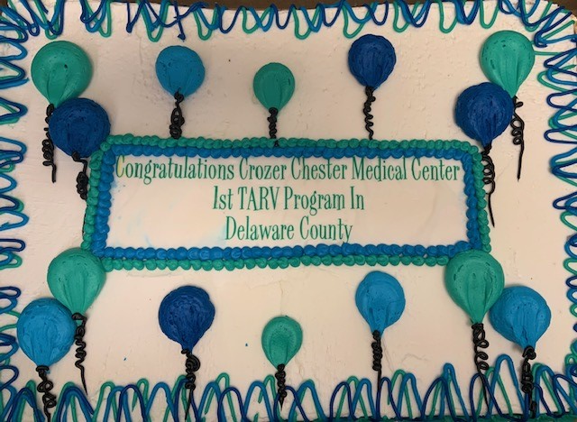
TAVR TUESDAY

Slide 7
WATCHMAN Device

Slide 8
WATCHMAN Device
What is the Watchman Device?
The WATCHMAN Device reduces the risk of stroke by closing off the left atrial appendage, which is known to be the main source of blood clots in patients with atrial fibrillation
Indicated to reduce the risk of thromboembolism from the left atrial appendage in patients with non-valvular atrial fibrillation.
First cases planned for March, 2020 at Crozer Chester Medical Center

Slide 9
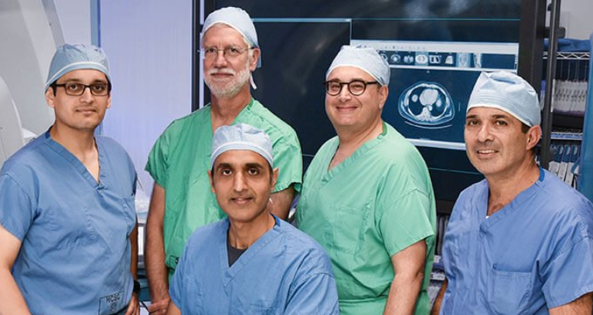
CKHS Structural Heart Team

